Slide 1

Talent as a Service (TaaS): Cultivating Future-Ready Engineering Talent
Beyond mere acquisition, our Talent as a Service (TaaS) program strategically cultivates and empowers future-ready engineering talent. We revolutionize your workforce, equipping it with the skills necessary for continuous innovation and sustained growth.

Slide 2






WHY TAAS? Addressing Critical Talent Challenges
The Talent Shortage Is Real
Traditional Hiring is Inefficient & Reactive
It's a tough market out there. Many companies are finding it incredibly difficult to pinpoint and hire the skilled tech talent they desperately need. Reports show that a staggering 75% of companies struggle to find qualified tech professionals, with 64% of tech projects actually being held back due to these critical IT talent gaps.
Waiting for the perfect candidate to appear can feel endless, and the traditional hiring process often struggles to keep up. Tech roles can take an average of 8 weeks to fill, causing significant project delays. Furthermore, this reactive approach frequently leads to about 25% attrition due to poor cultural or skill fit. Our TaaS program is designed to cut these hiring cycles by 50%.
The Challenge of Upskilling Young Engineers
Rapidly Evolving Skill Demands
The tech landscape changes constantly, leading to a persistent skills gap. What was cutting-edge yesterday might be obsolete tomorrow. Approximately 60% of employers report that their employees lack critical skills needed for future business growth, highlighting the need for continuous learning and adaptation. Businesses must proactively address this evolution to remain competitive.
Bringing new talent up to speed efficiently is a common hurdle. We understand the importance of nurturing potential. By investing in dedicated learning pipelines, companies can reduce their dependency on external hiring by 40%. Our internship-to-hire programs boast an impressive ~80% retention rate, and upskilled hires typically reach full productivity 30-50% faster than external recruits.

Slide 3

Our Comprehensive TAAS Program
Our unique program builds a robust pipeline of job-ready tech talent tailored to your specific needs.
Recruitment & Selection
Intensive Training & Development
Identifying top-tier talent through rigorous assessments and cultural fit analysis.
Customized programs focusing on cutting-edge technologies and soft skills.
Mentorship & Coaching
Deployment & Integration
Pairing talent with experienced professionals for personalized guidance.
Seamlessly integrating skilled professionals into your existing teams.

Slide 4
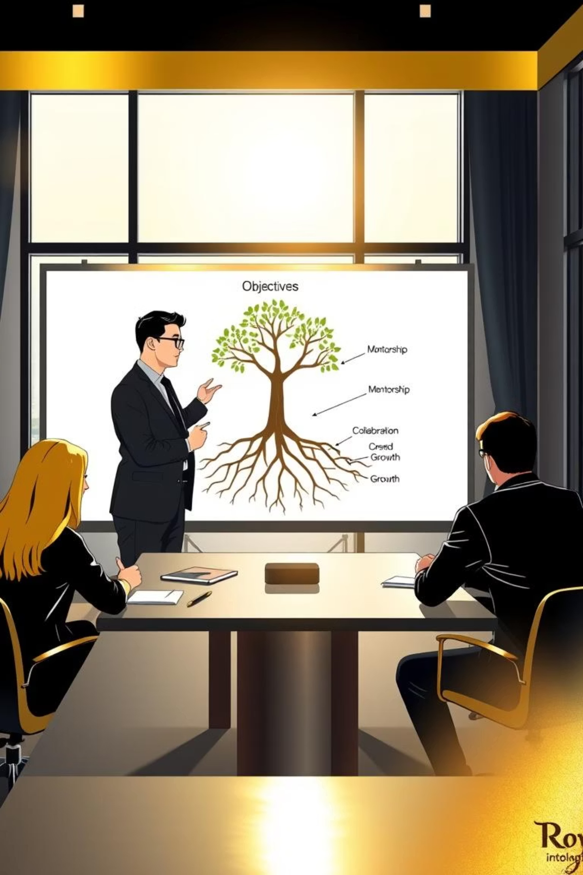
LEADER EXPECTATIONS
For leaders engaging with Talent as a Service, fostering a supportive environment is crucial for success and maximizing team potential.
Strategic Talent Acquisition
Cultivating Inclusivity
Prioritize hiring for expertise that complements the team's existing skill set, ensuring a well-rounded and high-performing unit.
Recruit with careful consideration for both diversity and cultural fit, enriching the team dynamic and fostering a welcoming environment.
Seamless Onboarding & Assimilation
Clear Objective Setting
Empower Team Members for success by establishing clear, measurable objectives that align with organizational goals.
Provide robust support to accelerate cultural assimilation, ensuring a smooth and effective transition for new team members.
Sustained Engagement & Retention
Actively lay the groundwork for long-term Team Member engagement and retention through consistent guidance and support.

Slide 5






TEAM MEMBER EXPERIENCE
We prioritize an empowering experience, ensuring every team member feels valued and thrives.
Welcomed & Supported
Heard & Understood
Motivated, welcomed, and supported from day one, ensuring a smooth and positive start.
Team members feel heard and understood; their opinions and potential are always valued.
Integrated & United
Cared For
Seamlessly integrated as part of the team and quickly assimilated into the culture.
Cared for as a person, fostering a strong sense of belonging and community.
Trusted & Autonomous
Empowered with trust and autonomy, enabling them to take ownership and innovate.

Slide 6
Our Unique Approach: Build, Grow, Deliver
1
2
3
Build
Grow
Deliver
We identify high-potential talent and provide intensive, hands-on training to cultivate job-ready skills aligned with industry demands.
Our continuous learning and mentorship programs ensure ongoing professional development, transforming talent into future leaders.
Seamless integration into your teams, providing immediate value and driving project success with highly productive talent.

Slide 7
Internship Journey: From Learning to Leadership
Our comprehensive internship program is designed to transform aspiring engineers into skilled professionals and future leaders. It's a journey of continuous learning, practical application, and accelerated career growth.
Structured Curriculum
Practical Experience
Foundational skills in programming, data structures, and algorithms.
Participation in live product development cycles.
Hands-on projects with real-world applications.
Specialized tracks in AI/ML, Full-Stack, Automation Testing, Quantum Computing
Career Acceleration
Mentorship & Support
Offers to top performers based on overall fit.
Fast-track integration into full-time roles.
Dedicated mentors provide technical guidance and coaching.
Regular feedback sessions to track progress.

Slide 8




MEASURABLE OUTCOMES
Sustainable Talent Pipeline
Accelerated Time-to-Productivity
80% of interns seamlessly transitioned into full-time engineering roles, fueling long-term team growth.
Reduced onboarding and ramp-up time by 40%, enabling faster project contributions.
Business-Aligned Outcomes
Future-Ready Engineering Talent
Intern projects delivered tangible value, earning positive feedback from mentors and business stakeholders.
Nurturing engineers equipped with real-world skills and a strong ownership mindset.

